Slide 1
CONVEGNO INTERNAZIONALE TAOBUK FESTIVAL TAORMINA 2022
QUAL E’ IL FUTURO DELLA SCIENZA MEDICA ?

Slide 2



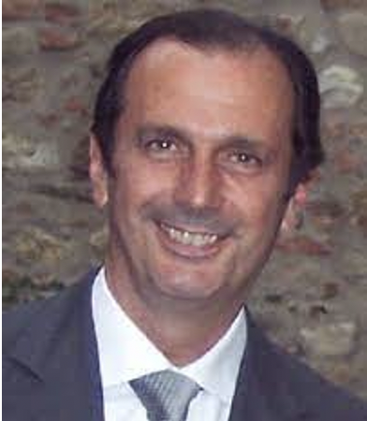
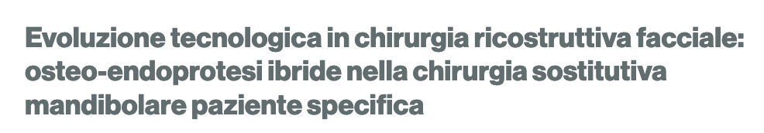
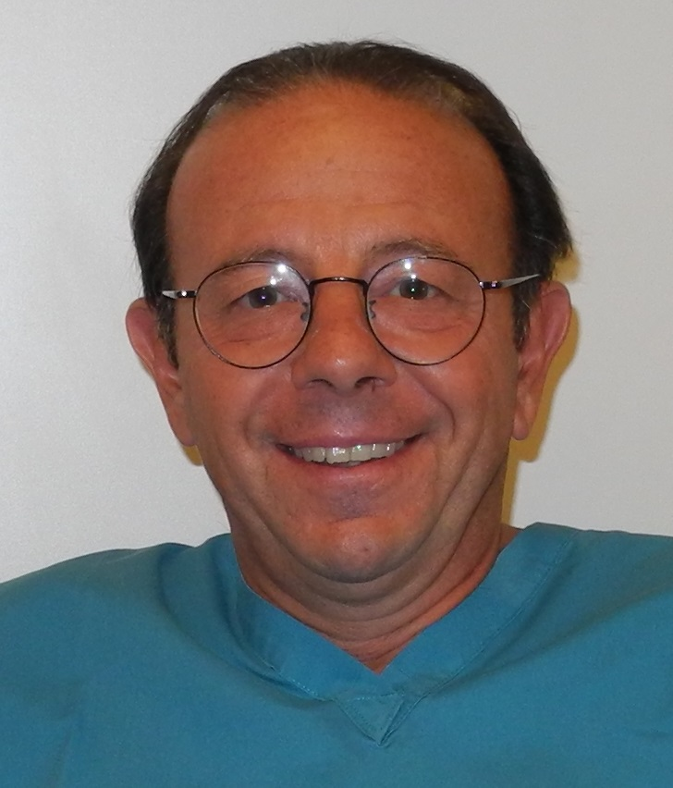
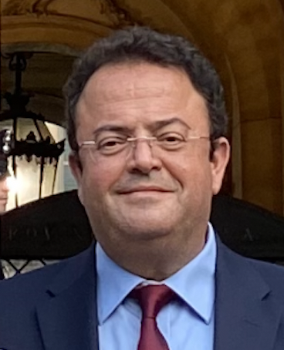



2022
Bruno Pesucci - Roberto Pistilli - Flavio Govoni
U.O.C. di Chirurgia Maxillo-Facciale (Dir.: Prof. B.A. Pesucci)
A.O. San Camillo-Forlanini - Roma

Slide 3
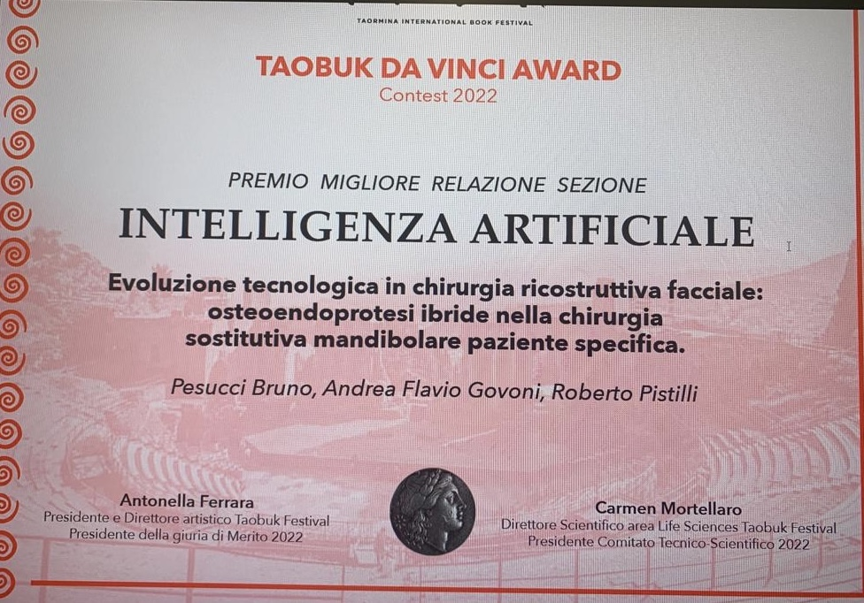

Slide 4


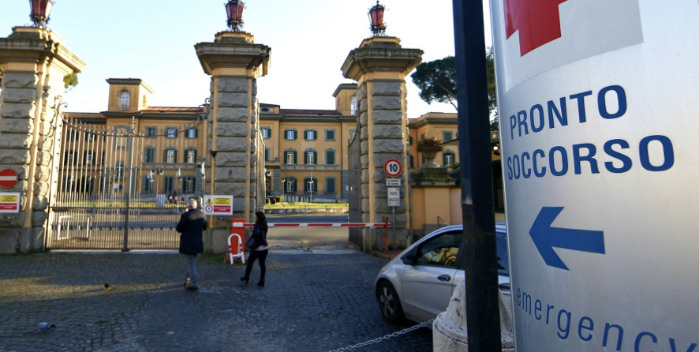
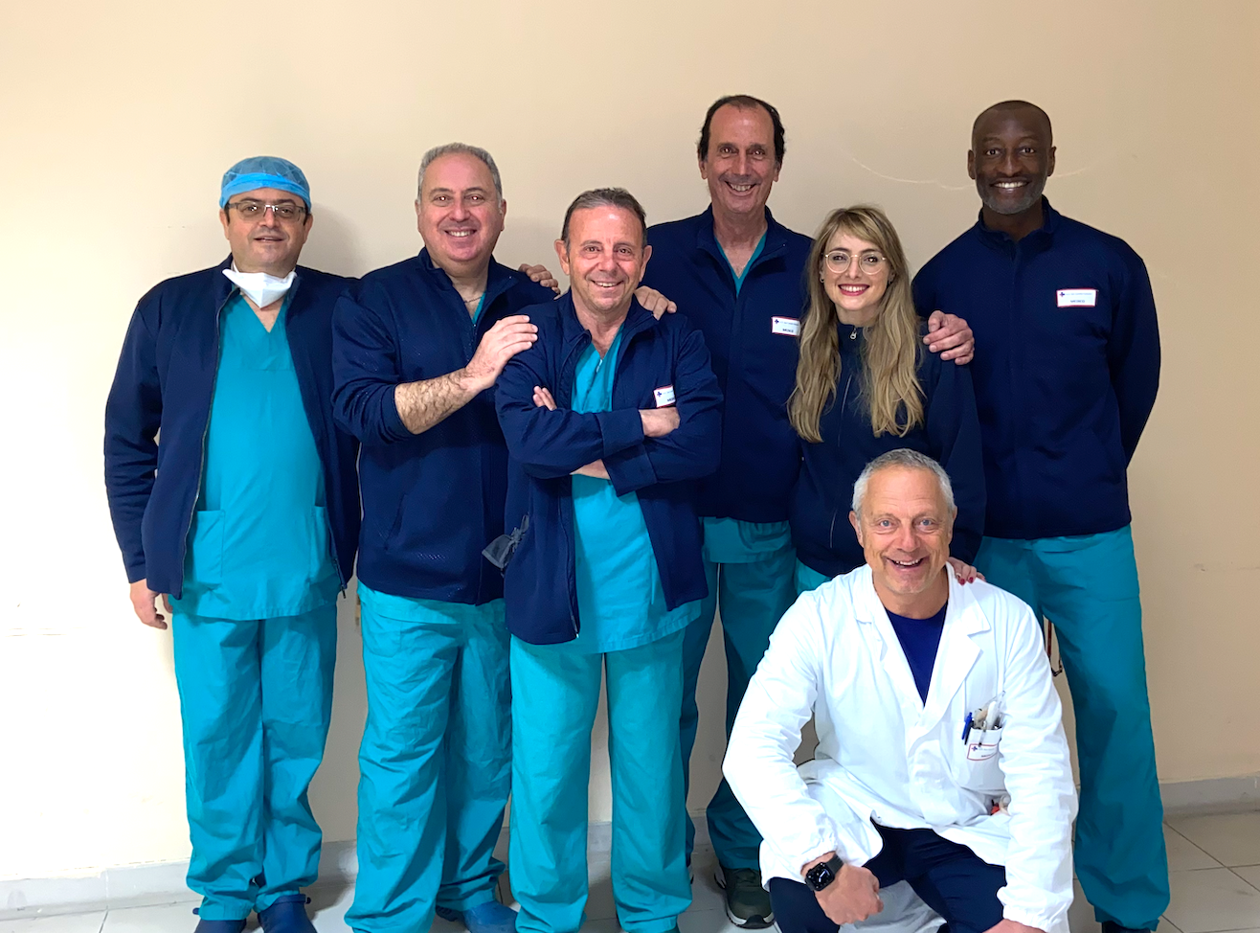
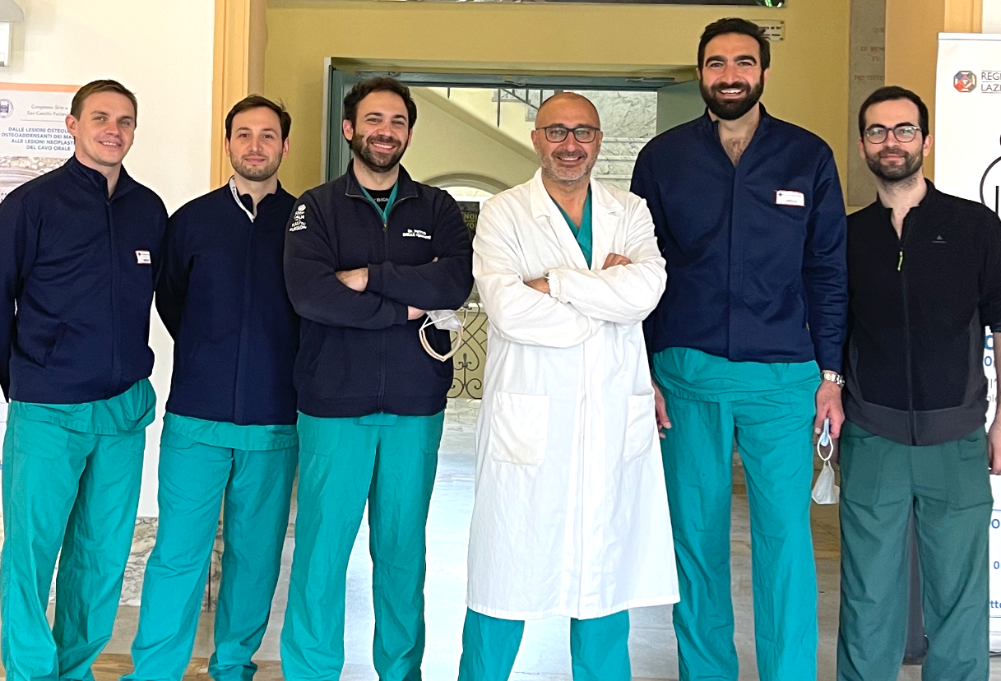
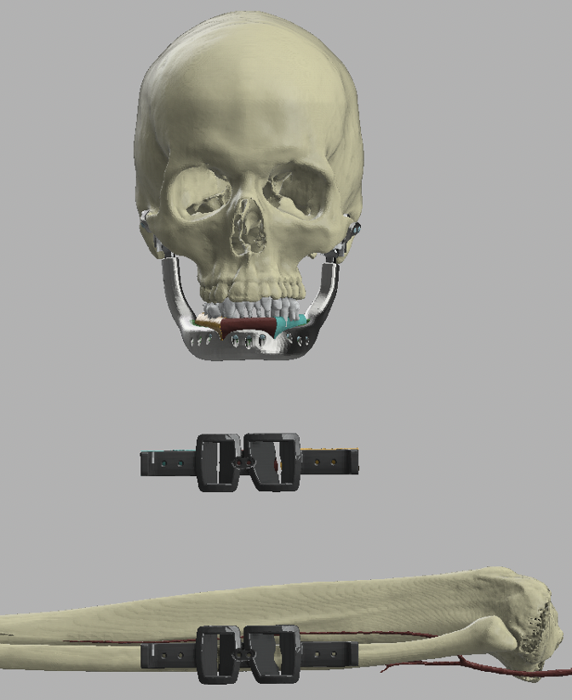
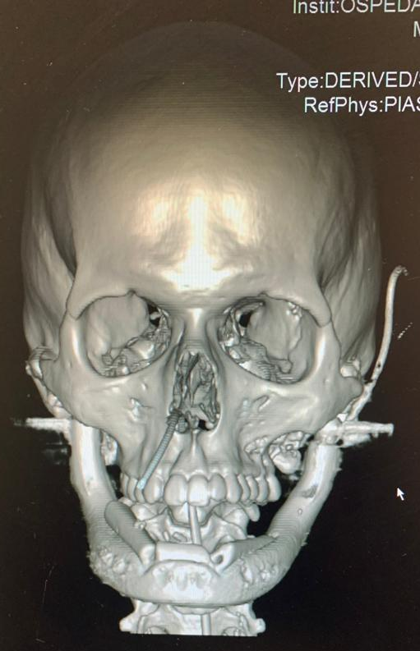
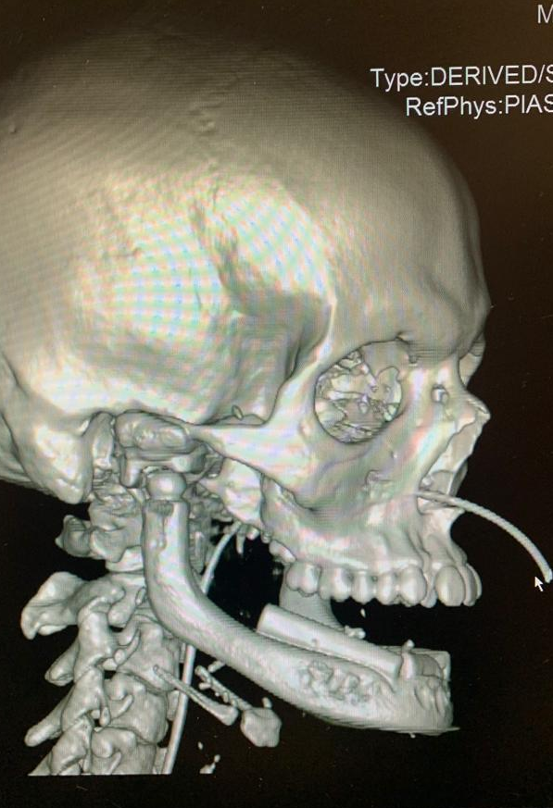
San Camillo-Forlanini Hospital of Rome - Italy
1) Unit of Maxillofacial Surgery (Head: Prof. B.A. Pesucci),
2) Unit of Plastic and Recon. Surgery of the Limbs (Head Prof. N. Felici)
Real total mandibular bone and bilateral tmj replacement by a custom-made jaw and tmj prosthesis supporting a free fibula bone flap: case report and technical consideration on a new mandibular patient specific implant
Flavio Andrea Govoni ¹, Roberto Pistilli ¹, Vincenzo Antonio Marcelli ¹, Bruno Andrea Pesucci ¹
Nicola Felici ², Matteo Ornelli ²,

Slide 5
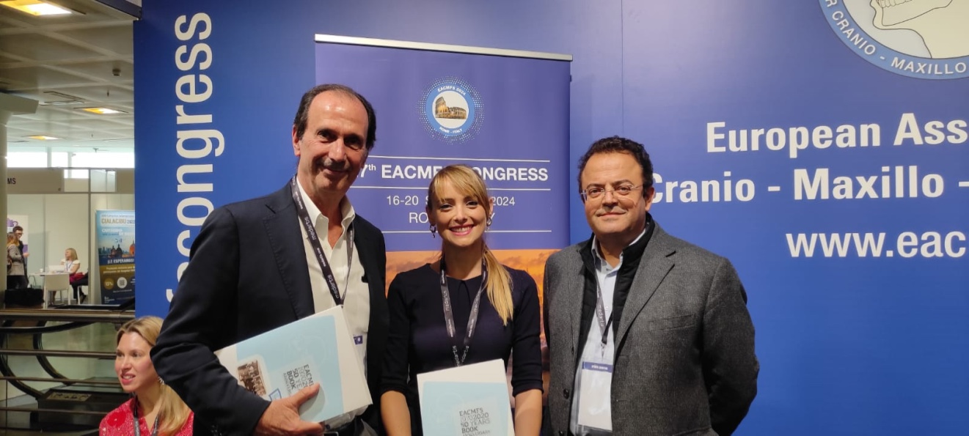
CONGRESSO SOCIETA’ EUROPEA CHIRURGIA MAXILLO FACCIALE – MADRID 2022

Slide 6

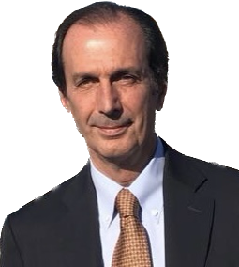
CORSO FAD 2023 : LA RIABILITAZIONE IMPLANTO-PROTESICA DEL PAZIENTE CON DEFICIT OSSEI POST-TRAUMATICI, DA PARODONTOPATIA E DA RESEZIONI POST-ONCOLOGICHE
LA RIABILITAZIONE DEI GRAVI DEFICIT OSSEI
POST-TRAUMATICI DEL MASCELLARE
BRUNO ANDREA PESUCCI
UOC CHIRURGIA MAXILLO FACCIALE
OSPEDALE SAN CAMILLO - ROMA

Slide 7
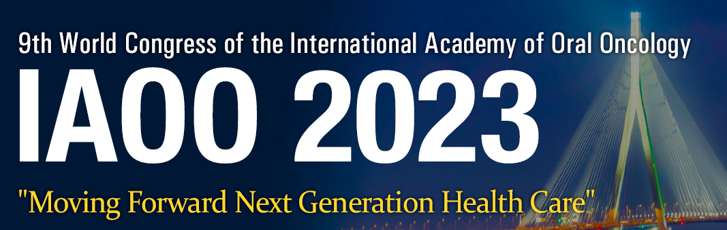

Total Mandibular Bone and Bilateral TMJ Replacement by custom-made jaw and TMJ prosthesis supporting a free fibula bone flap: case report and technical consideration.
F.A. Govoni, R. Pistilli, V.A. Marcelli, R. Pucci, F. Pica, I.V. Aboh, B. A. Pesucci
1) Unit of Maxillofacial Surgery (Head: Prof. B.A. Pesucci),
2) Unit of Plastic and Recon. Surgery of the Limbs (Head Prof. N. Felici)
San Camillo-Forlanini Hospital of Rome - Italy
Notes:
Total Mandibular Bone and Bilateral TMJ Replacement by custom-made jaw and TMJ prosthesis supporting a free fibula bone flap: case report and technical consideration.

Slide 8
Mandibular Macro-Microporous Patient-Specific Implant Reconstruction: Technologic Evolution of VSP, CAD-CAM and Recipient Bone Techinques.
B.A. Pesucci, R. Pistilli, F. Pica, R. Pucci, V.A. Marcelli, C. Macro, I.V. Aboh, F.A. Govoni
1) Unit of Maxillofacial Surgery (Head: Prof. B.A. Pesucci),
2) Unit of Plastic and Recon. Surgery of the Limbs (Head Prof. N. Felici)
San Camillo-Forlanini Hospital of Rome - Italy
Notes:
Total Mandibular Bone and Bilateral TMJ Replacement by custom-made jaw and TMJ prosthesis supporting a free fibula bone flap: case report and technical consideration.

Slide 9
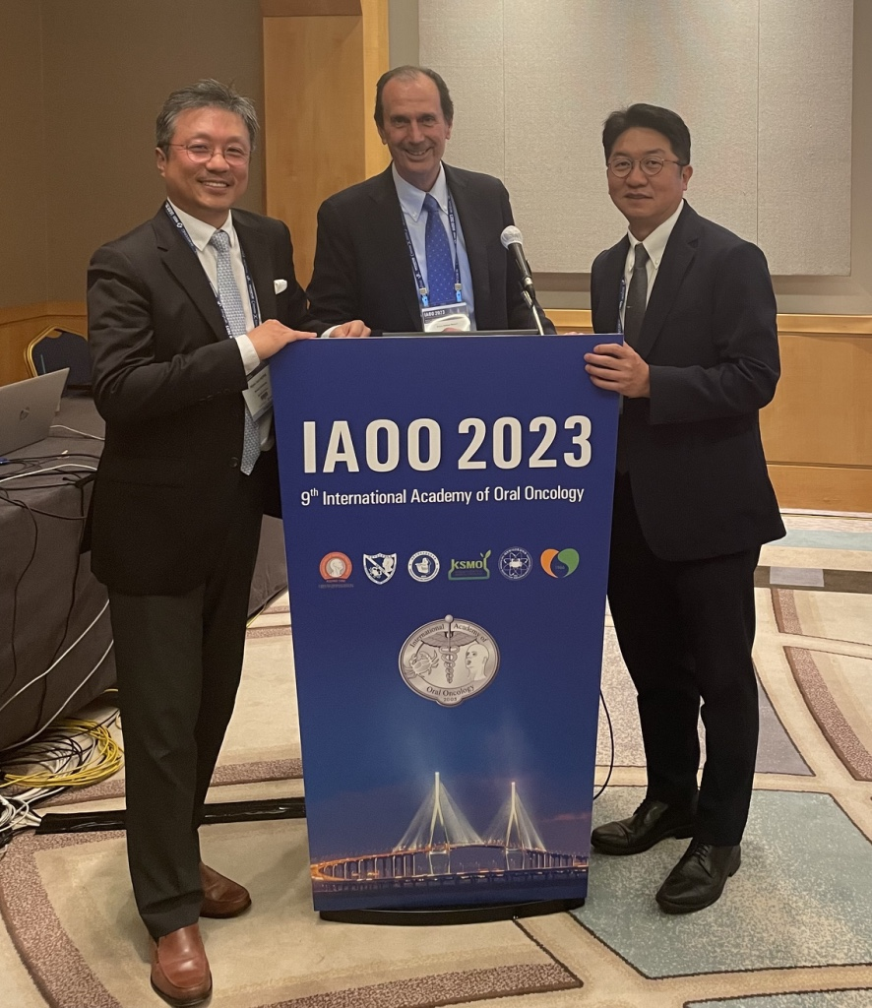

Slide 10
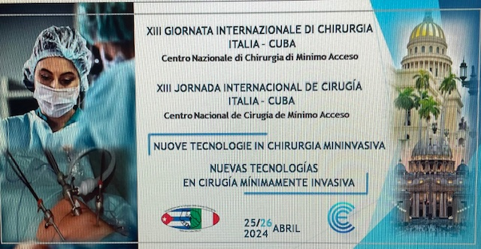
Unit of Maxillofacial Surgery (Head: Prof. B.A. Pesucci),
San Camillo-Forlanini Hospital of Rome – Italy
VENTAJAS DE LAS NUEVAS TECNOLOGIAS EN LA RECONSTRUCCION POST-ONCOLOGICA FACIAL

